Slide 1
Data structures and Algorithms

Slide 2
Bubble Sort
Basic idea (lighter bubbles rise to the top):
Start from the bottom of the array
Exchange neighbouring items if unsorted until the smallest (lightest) item reaches the top of the array
Repeat for the rest of the array

Slide 3
int[] array = { 5, 2, 9, 1, 5, 6 };

Slide 4
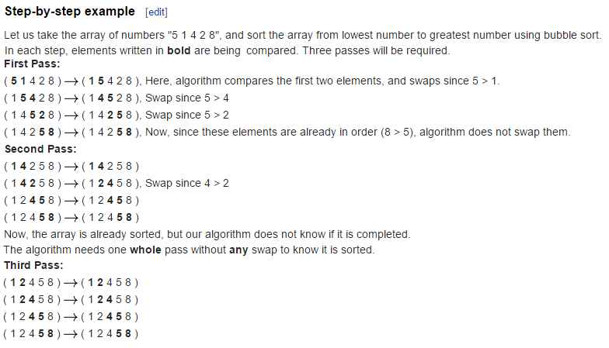
Bubble sort

Slide 6
Bubble sort complexity
Best case? List is already sorted, O(n)
Outer loop? n times
So n-1 comparisons each time? (and possible swaps)
5,3,7,9,8

Slide 7
Optimized Bubble sort
for (int i = 0; i < n - 1; i++)
swapped = false;
for (int j = 0; j < n - i - 1; j++)
if (arr[j] > arr[j + 1]) {
// Swap arr[j] and arr[j+1]
int temp = arr[j];
arr[j] = arr[j + 1];
arr[j + 1] = temp;
swapped = true;
if (!swapped) {
break;

Slide 8
Comparison
How do we compare algorithms?
Running time?
Memory usage?

Slide 9
Analysis
Best case
Average case
Worst case
Big-Oh
Big Theta
Big Omega
Little-Oh

Slide 10
Which one to use?
1 -> Analyze for Worst case
2-> Look at the problem domain and then decide.

Slide 11
How do we calculate running time?
Manually -> Using a watch
Using logs and time functions
Problem size -> n, 2n, 4n, ……

Slide 12
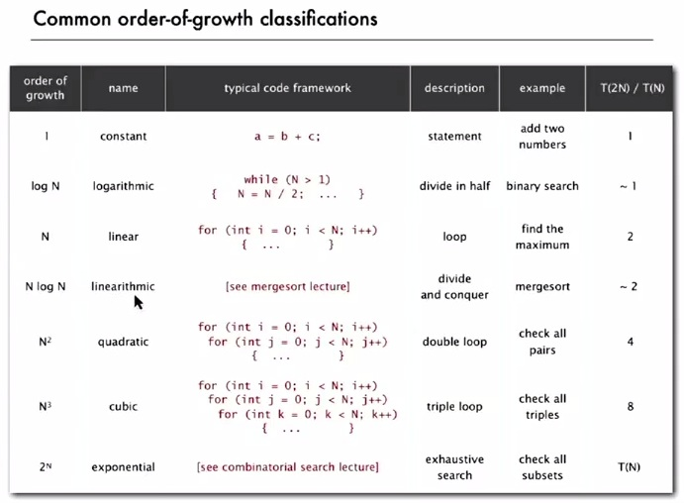

Slide 13
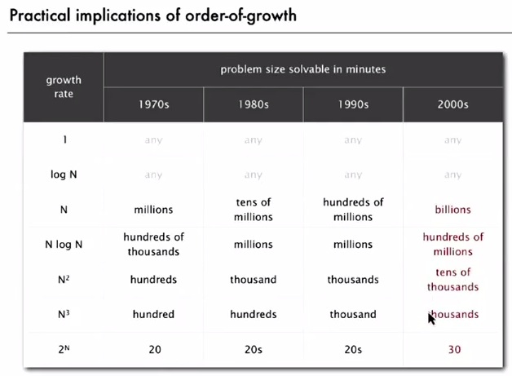

Slide 14
Running time
Search an array A for a number n
For i=1 … n
If i==n return n
Return 0

Slide 15
Code
int n=5, a[10];
For (int i=0;i<10;i++)
If(a[i] == n) return n
Return 0

Slide 16
Same problem as before
But this time, we have two arrays a and b.
int n=5, a[10], b[10];
For (int i=0;i<10;i++)
If(a[i] == n) return n
Return 0
For (int j=0;j<10;j++)
If(b[j] == n) return n
Return 0

Slide 17
Example 3
Find if there are any common integers in a and b
Code -> ?

Slide 18
Running time
Total running time of a program is determined by two primary factors:
The cost of executing each statement
The frequency of execution of each statement

Slide 19
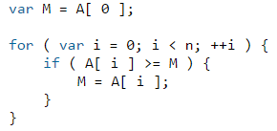
Example 4
Assigning a value to a variable
Looking up the value of a particular element in an array
Comparing two values
Incrementing a value
Basic arithmetic operations such as addition and multiplication
The init statement is run. 2. The test is evaluated to be true or false. 3. If the test is true, jump to step 4. If the test is false, jump to step 6. 4. Run the statements within the block. 5. Run the update statement and jump to step 2. 6. Exit the loop.
https://processing.org/reference/for.html

Slide 20
var M = A[ 0 ];
i = 0;
i < n;
++i;
i < n;
Total: 4 + 2n.
That is, 4 instructions at the beginning of the for loop and 2 instructions at the end of each iteration of which we have n

Slide 21
if ( A[ i ] >= M ) { ...
Two instructions.
If true then
M = A[ i ]
But how many times will M=A[i] execute? We don’t know.
We’ll just assume the worst, i.e. it will execute every times the loop executes, i.e. n

Slide 22
Simple Complexity Analysis: Loop Example
Find the exact number of basic operations in the following program fragment:
There are 2 assignments outside the loop => 2 operations.
The for loop comprises:
An assignment i = 0 that is executed once => 1 operation
A test i < n that is executed n + 1 times => n + 1 operations ( n operations is correct too)
An increment i++ consisting of 1 operation that is executed n times => n operations
the loop body that has three assignments, two multiplications, an addition and two array access. Theses 8 operations are executed n times => 8n operations
Thus the total number of basic operations is 8n + n + (n + 1) + 3
= 10n + 4
double x, y;
x = 2.5 ; y = 3.0;
for(int i = 0; i < n; i++){
a[i] = x * y;
x = 2.5 * x;
y = y + a[i];
}

Slide 23
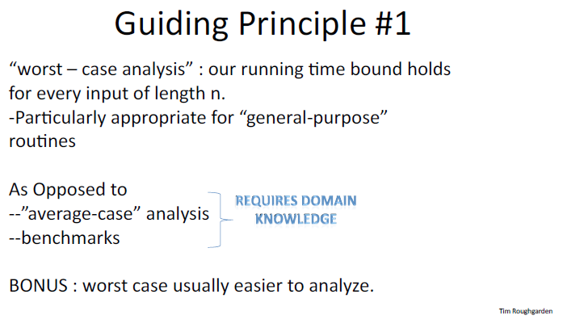

Slide 24
double x, y;
x = 2.5 ; y = 3.0;
for(int i = 0; i < n; i++){
a[i] = x * y;
x = 2.5 * x;
y = y + a[i];
}

Slide 25
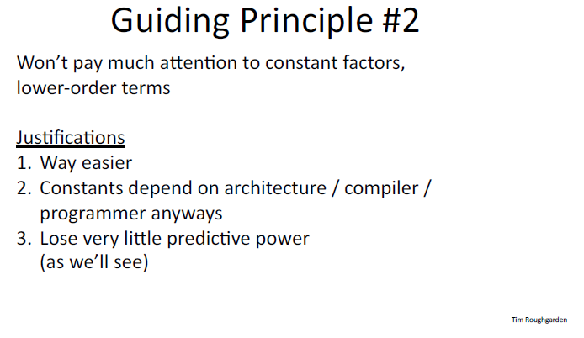

Slide 26
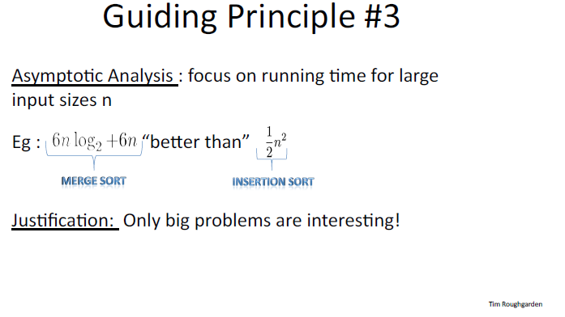

Slide 27
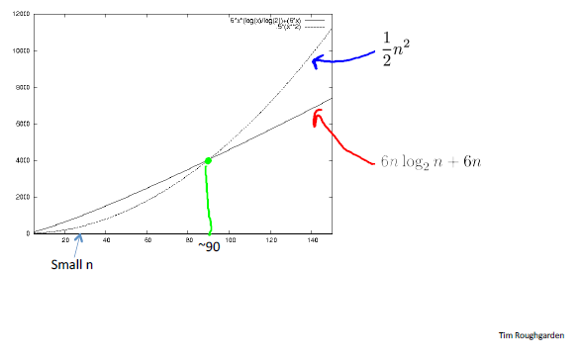

Slide 28
Asymptotic notation
Suppress Constant factors and lower-order terms.
The filter of "dropping all factors" and of "keeping the largest growing term" is called asymptotic behavior.

Slide 29
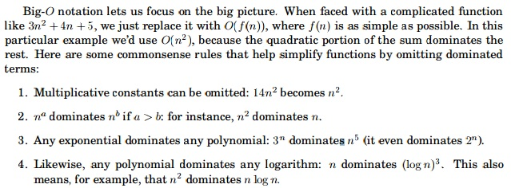
Big-O notation

Slide 30
Big-Oh
T(n) = function on n
T(n) = O(f(n))
iff there exist constants c, n0 > 0 such that
T(n) <= c. f(n)
for all n >= n0
OR
If eventually, for all large values of n, T(n) is BOUNDED ABOVE by a constant multiple of f(n)
For example 2. f(n) eventually crosses T(n) for all values
n >= n0

Slide 31
E.g 1
If T(n) = ak n^k + ak-1n^k-1 +….. a1n1 + a0
Then T(n) = O(n^k)

Slide 32
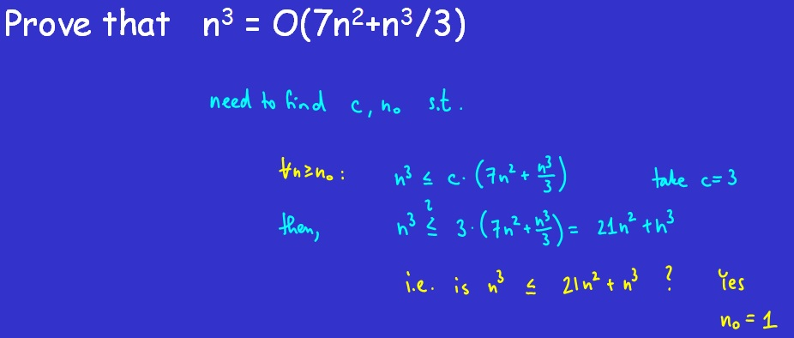
E.g 2

Slide 33
E.g. 3
T(n) = 1/2n^2+3n

Slide 34
E.g 4
2^n+10 = O (2^n)
2^n * 2^10
2^n * 1024
So for c = 1024 and n=1
2^11 = 1024 * 2^1

Slide 35
E.g 5
2^10n is NOT O(2^n)
2^10n <= c. 2^n
Divide by ^n
2^9 <= c
So 2^10n is not O(2^n)

Slide 36
References
http://discrete.gr/complexity/
wikipedia

